Slide 1




Chapter 16:
Filecoin boost
Beginners Guide to Filecoin
Content created by Brown Zhang
Researcher @ KEN Labs

Slide 2

What is Boost?
Boost is a tool for Storage Providers to manage data onboarding and retrieval on the Filecoin network. It replaces the go-fil-markets package in lotus with a standalone binary that runs alongside a Lotus daemon and Lotus miner.
Boost exposes libp2p interfaces for making storage and retrieval deals, a web interface for managing storage deals, and a GraphQL interface for accessing and updating real-time deal information.

Slide 3
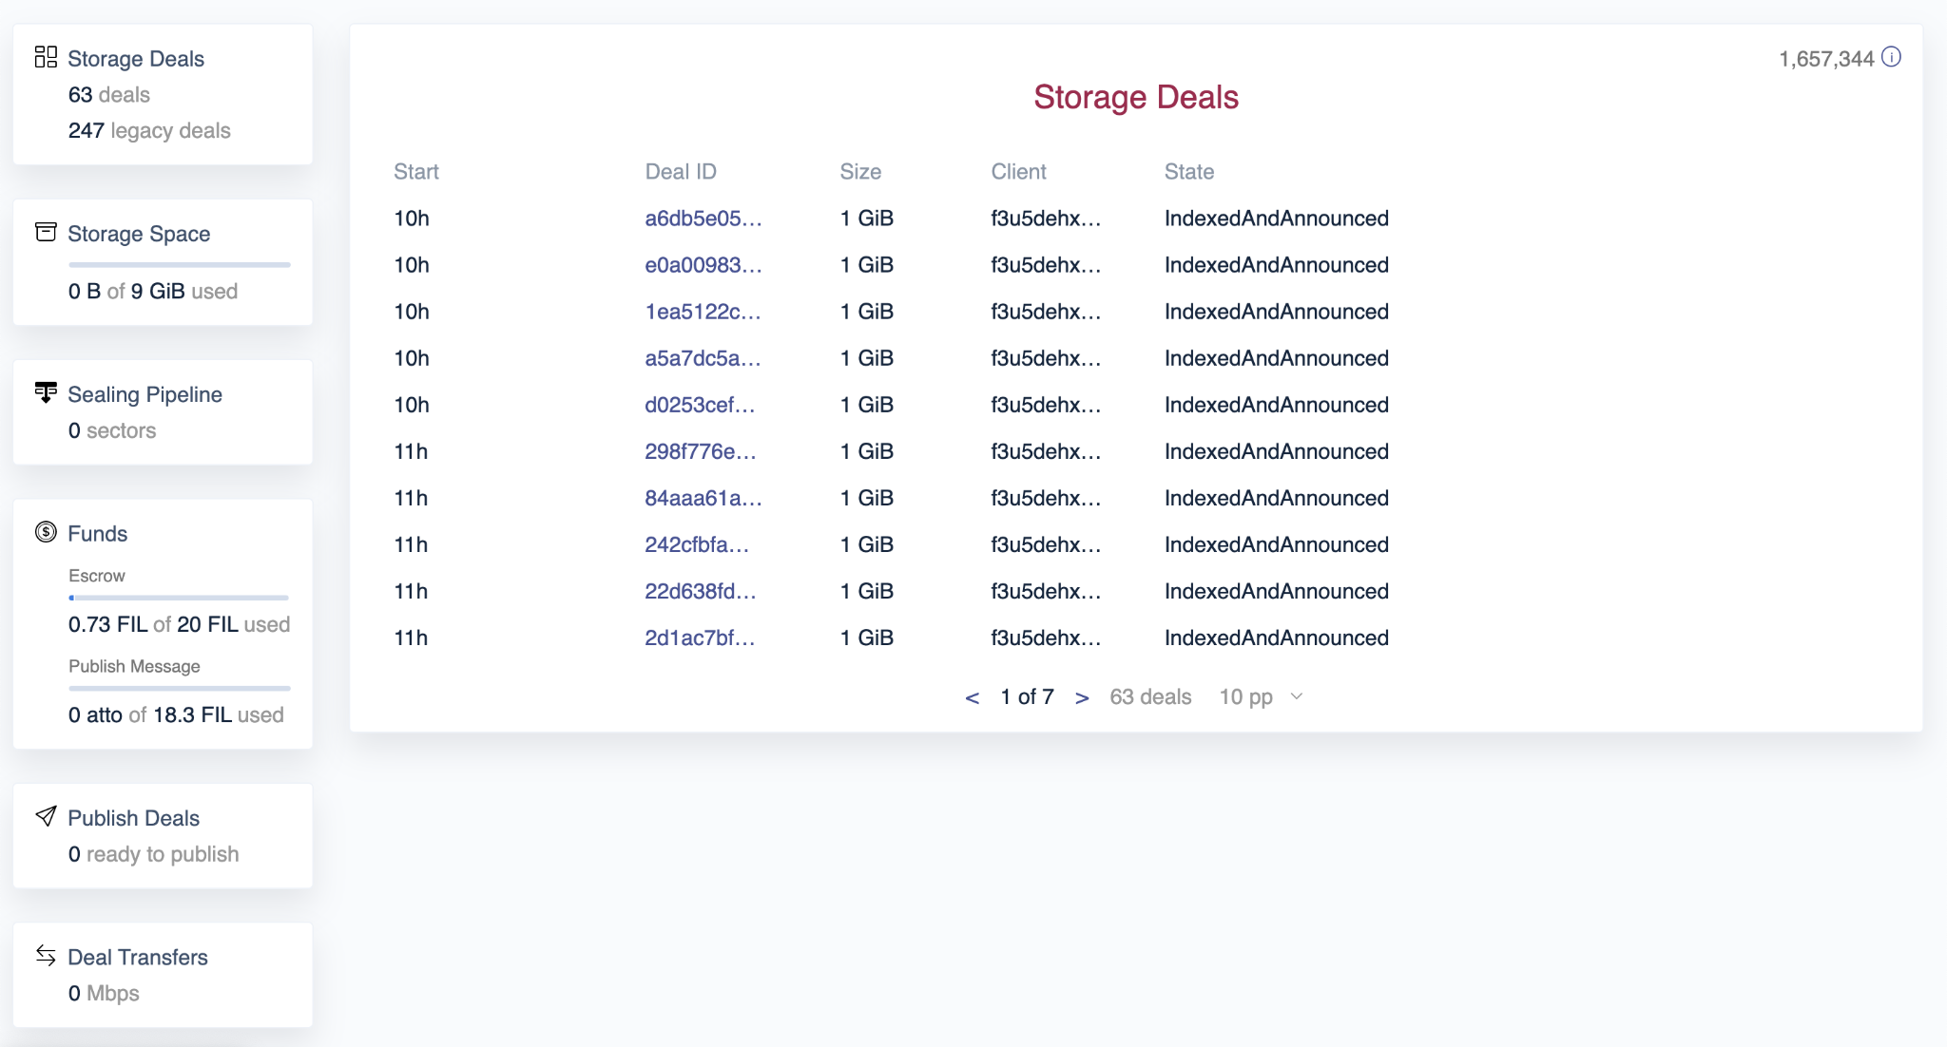
Features
Make storage deals with HTTP data transfer
Boost supports multiple options for data transfer when making storage deals, including HTTP. Clients can host their CAR file on an HTTP server, such as S3, and provide that URL when proposing the storage deal. Once accepted, Boost will automatically fetch the CAR file from the specified URL.
Web UI
Boost comes with a web interface that can be used to manage deals, watch disk usage, monitor funds, adjust settings and more.
Backwards compatibility with go-fil-markets package
A client for proposing deals that doesn't require a Lotus node

Slide 4
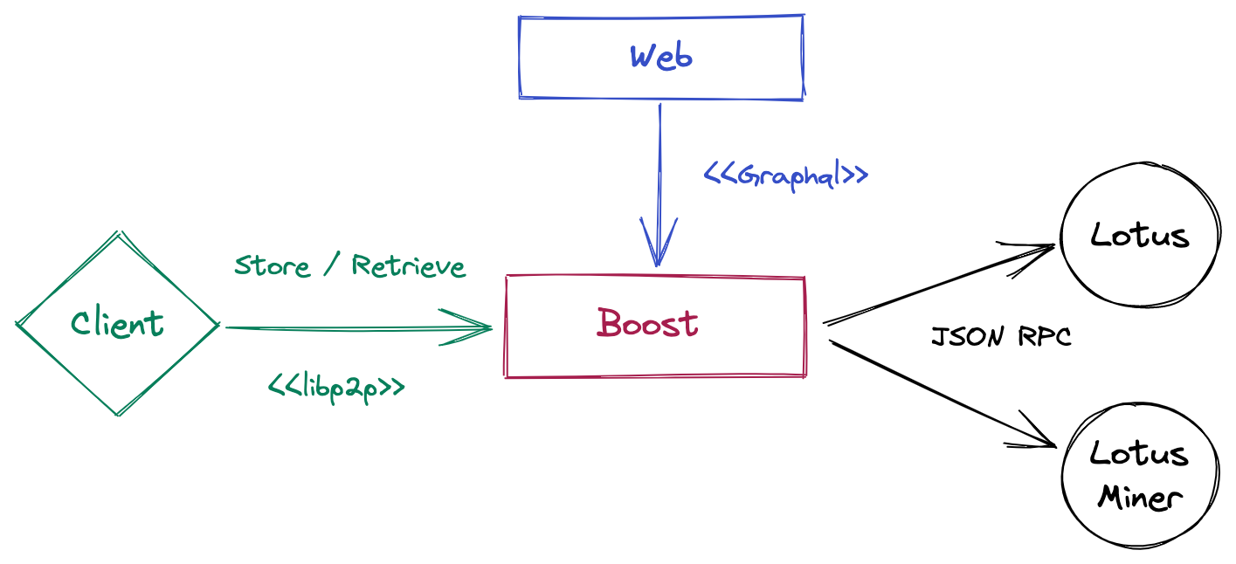
Architecture
The boost daemon exposes a libp2p interface for storage and retrieval deals. It performs on-chain operations by making API calls to the lotus node. The daemon hands off downloaded data to the lotus miner for sealing via API calls to the lotus miner.
boostd has a web interface for fund management and deal monitoring. The web interface is a react app that consumes a graphql interface exposed by the daemon.

Slide 5
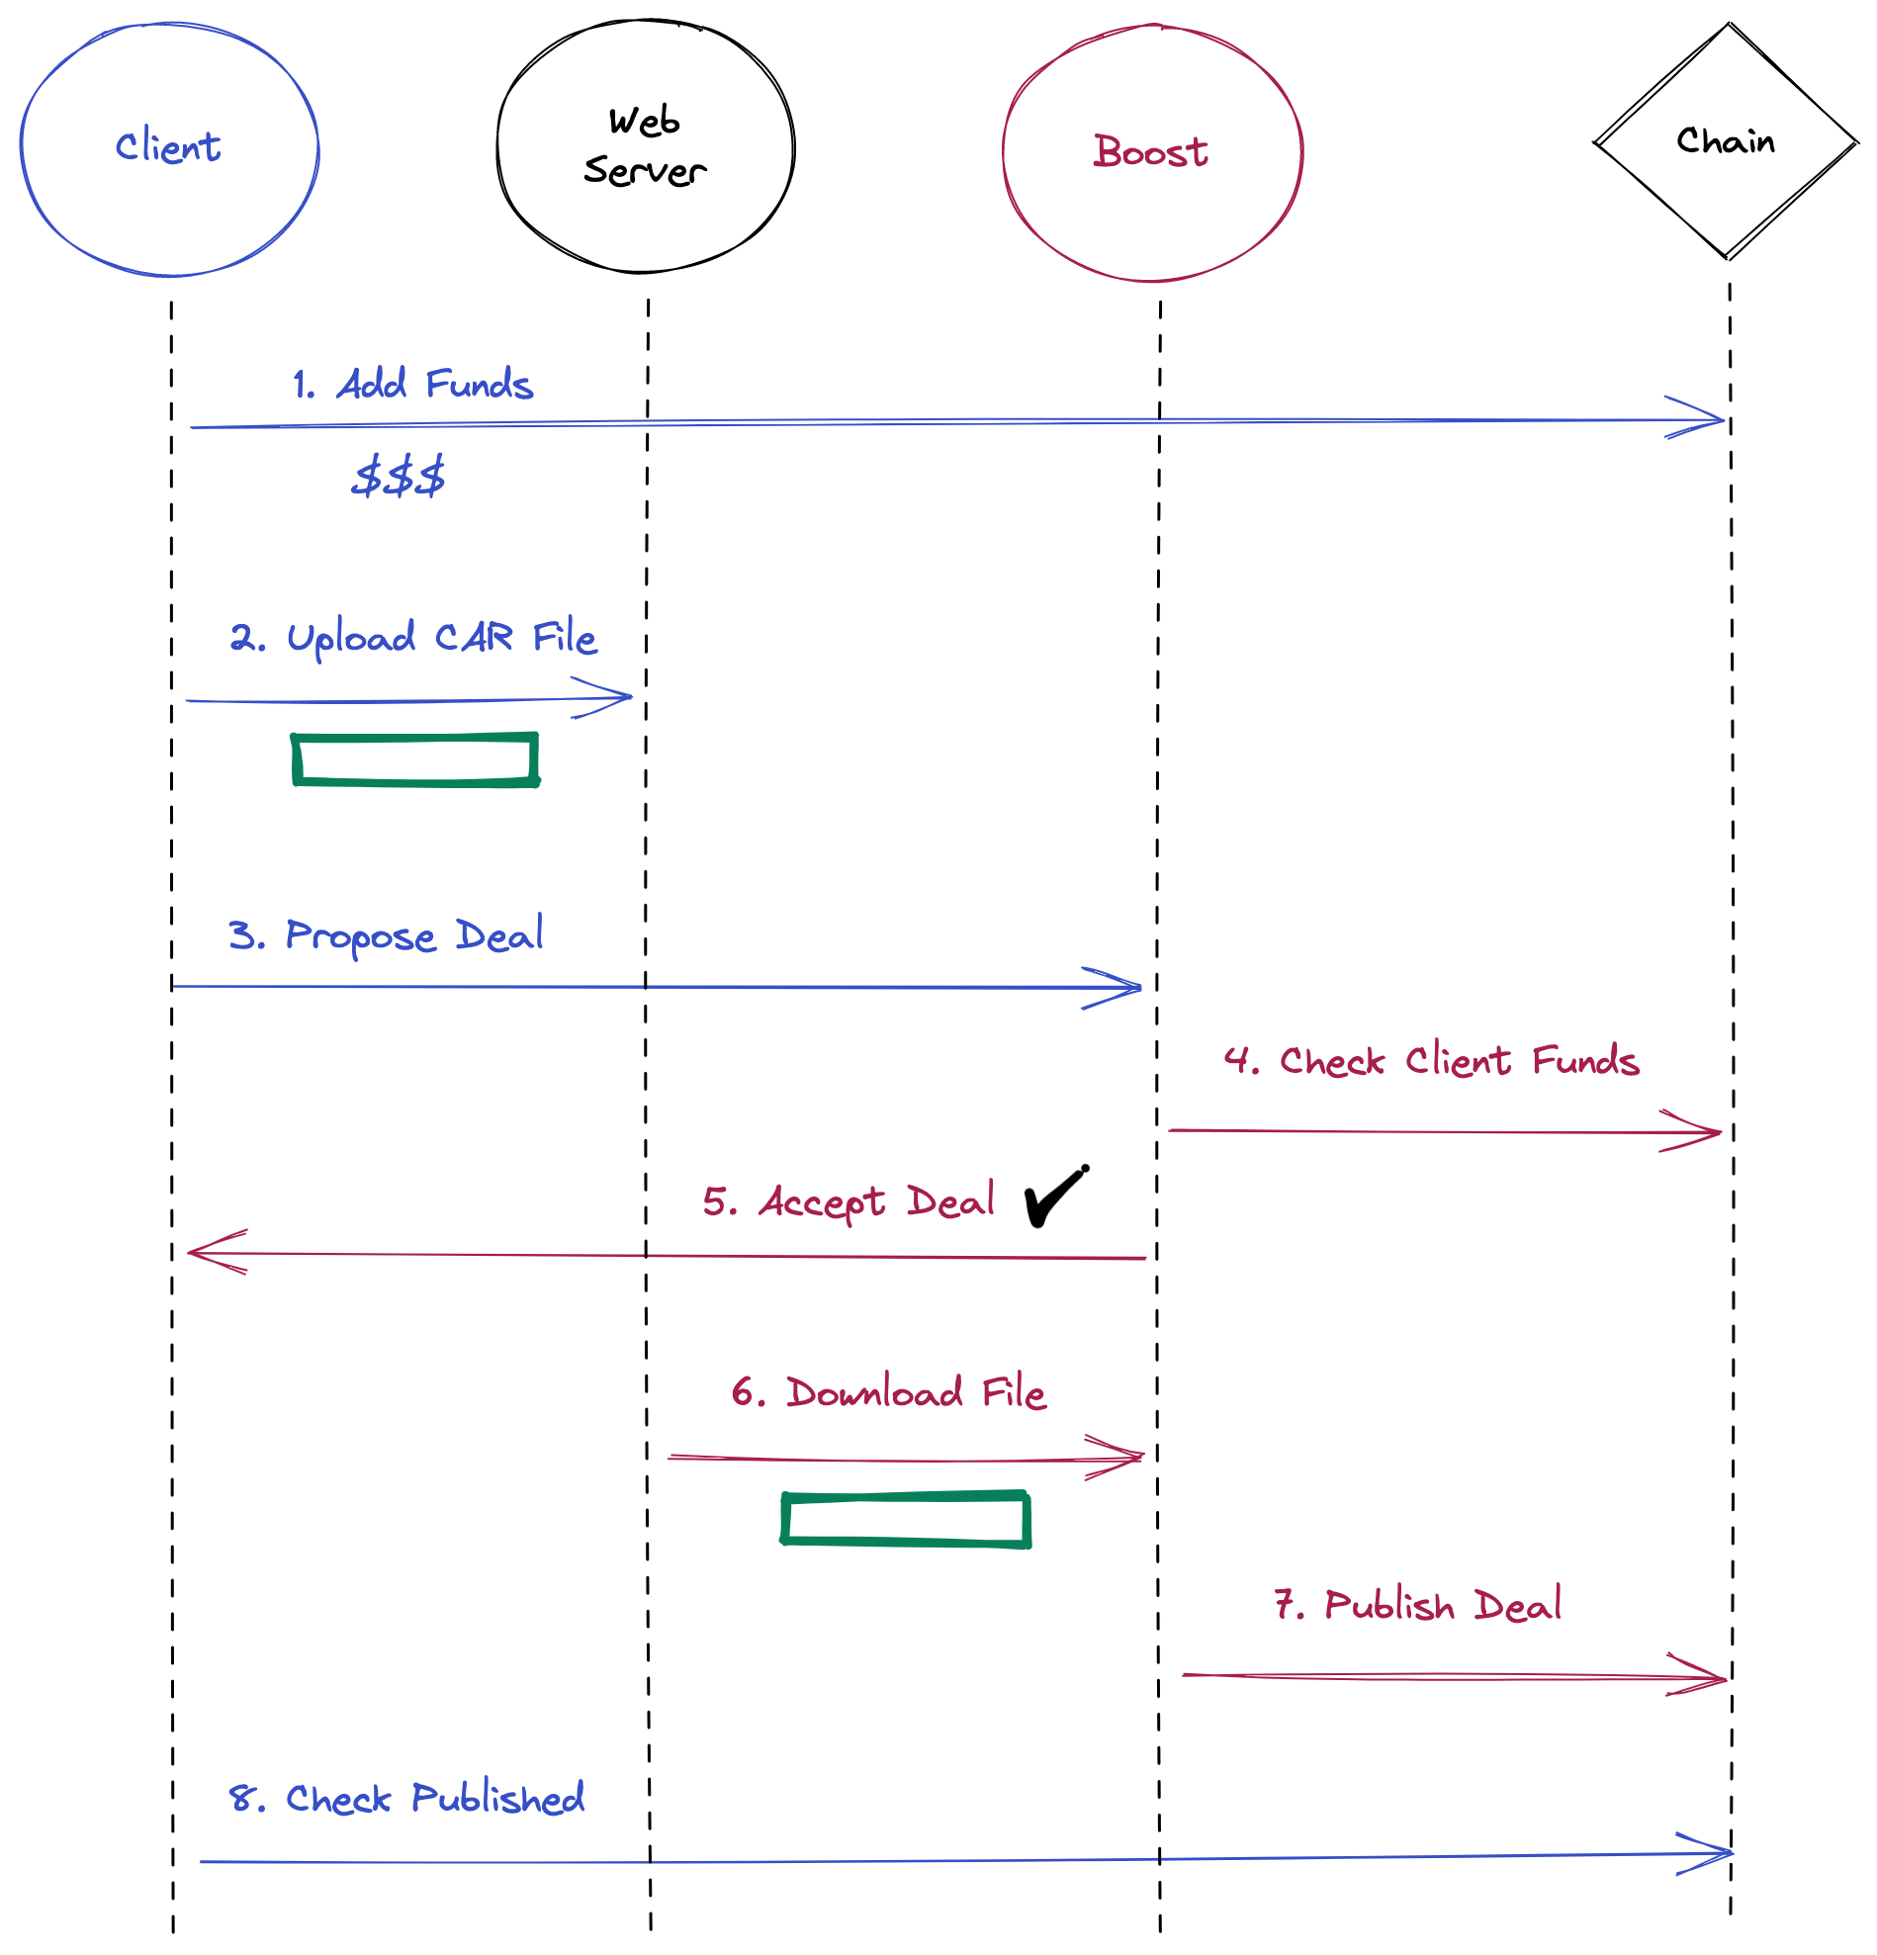
Architecture
Storage Deal Flow
The Client puts funds in escrow with the Storage Market Actor on chain.
The Client uploads a CAR file to a web server.
The Client sends a storage deal proposal to Boost with the URL of the CAR file.
Boost checks that the client has enough funds in escrow to pay for storing the file.
Boost accepts the storage deal proposal.
Boost downloads the CAR file from the web server.
Boost publishes the deal on chain.
The client checks that the deal was successfully published on chain.

Slide 6
Hardware requirements
The hardware requirements for Boost are tied to the sealer part of the Lotus deployment it is attached to.
General hardware requirements
CPU
A miner will need an 8+ core CPU.
The most significant computation that Boost has to do is the Piece CID calculation (also known as Piece Commitment or CommP). When Boost receives data from a client, it calculates the Merkle root out of the hashes of the Piece (padded .car file). The resulting root of the clean binary Merkle tree is the Piece CID. RAM
2 GiB of RAM are needed at the very least.
Disk
For small deployments 100 GiB of disk are needed at the very least if we assume that Boost is to keep three 32 GiB sectors before passing them to the sealing subsystem.

Slide 7
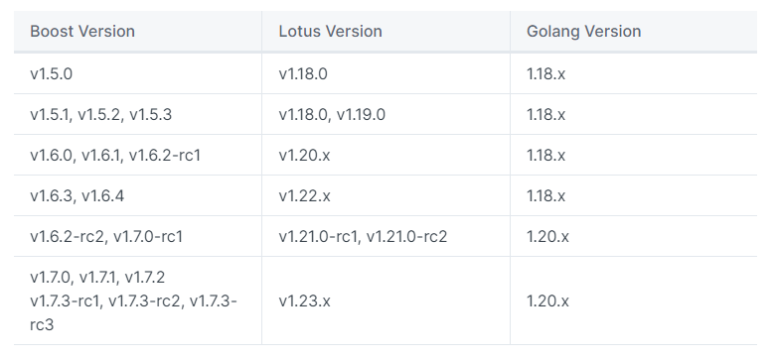
Getting started
Boost and Lotus compatibility Matrix
Building and installing
Please make sure you have installed:
Go - following https://go.dev/learn/
Rust - following https://www.rust-lang.org/tools/install
Node 16.x
Environment Variables in Boost
Linux / Ubuntu
MacOS
Upgrading Boost https://boost.filecoin.io/getting-started

Slide 8
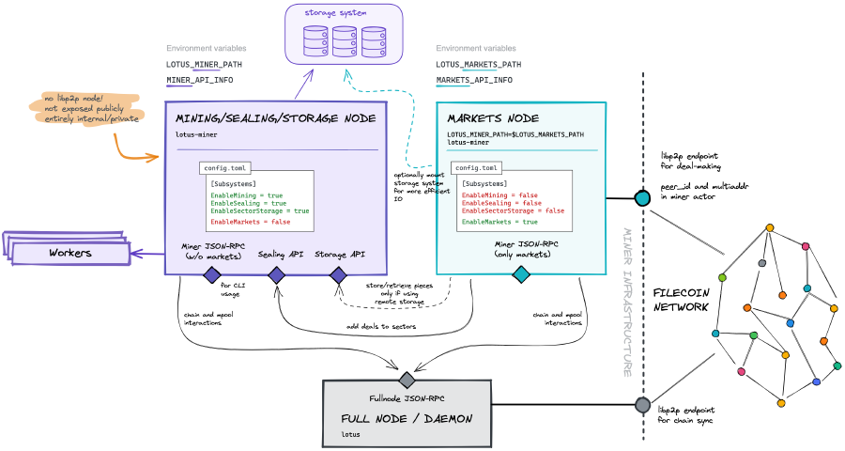
Migrate from Lotus to Boost
A storage provider can run the lotus as a monolith process where everything is handled by a single lotus-miner process or separate the mining and market subsystems on different machines.
Boost supports migration from both monolith and a split-market miner. You can follow the below guides to migrate to boost.

Slide 9
Boost other functions
Configuration https://boost.filecoin.io/configuration
Backup and Restore https://boost.filecoin.io/backup-and-restore
How to store files storage and retrieval deals https://boost.filecoin.io/tutorials/how-to-store-files-with-boost-on-filecoin
Using filters for storage and retrieval deals https://boost.filecoin.io/tutorials/using-filters-for-storage-and-retrieval-deals
Setting up a monitoring stack for Boost https://boost.filecoin.io/tutorials/setting-up-a-monitoring-stack-for-boost
Bitswap Retrieval https://boost.filecoin.io/bitswap-retrieval
HTTP Retrieval https://boost.filecoin.io/http-retrieval/serving-files-with-booster-http

Slide 10
Conclusion
Boost is a tool for Storage Providers to manage data onboarding and retrieval on the Filecoin network.

Slide 11


Feedback is welcomed.
https://github.com/kenlabs/Beginners-Guide-to-Filecoin

